Slide 1


Stock Price Prediction using ARIMA Model
Allan Johns
Amritesh Vadakkedath Babu
Asin Sona Thomas
Snehagee Keshavan Saji

Slide 2


Introduction
Time series analysis is a statistical technique that deals with time-ordered data points. It is widely used in various fields such as economics, finance, environmental studies, and more.
In the financial sector, predicting stock prices is crucial for making informed investment decisions.
Accurate forecasting models can provide significant advantages to traders and investors.

Slide 3

Objective and Data Source
Objective
To predict Tesla’s stock prices using the ARIMA model.
Data Source
Yahoo Finance - Tesla - Historical Stock Price Data
Period – Daily
Start Date - 2020-01-01
End Date - 2024-06-17

Slide 4
ARIMA – An Overview
Auto-Regressive Integrated Moving Average.
It is a popular and widely used statistical method for time series forecasting.
ARIMA models are capable of capturing different standard temporal structures in time series data.

Slide 5
Components of ARIMA
The ARIMA model is characterized by three parameters: p, d, and q:
p : The number of lag observations included in the model (autoregressive part).
d : The number of times that the raw observations are differenced to make the time series stationary (integrated part).
q : The size of the moving average window (moving average part).

Slide 6
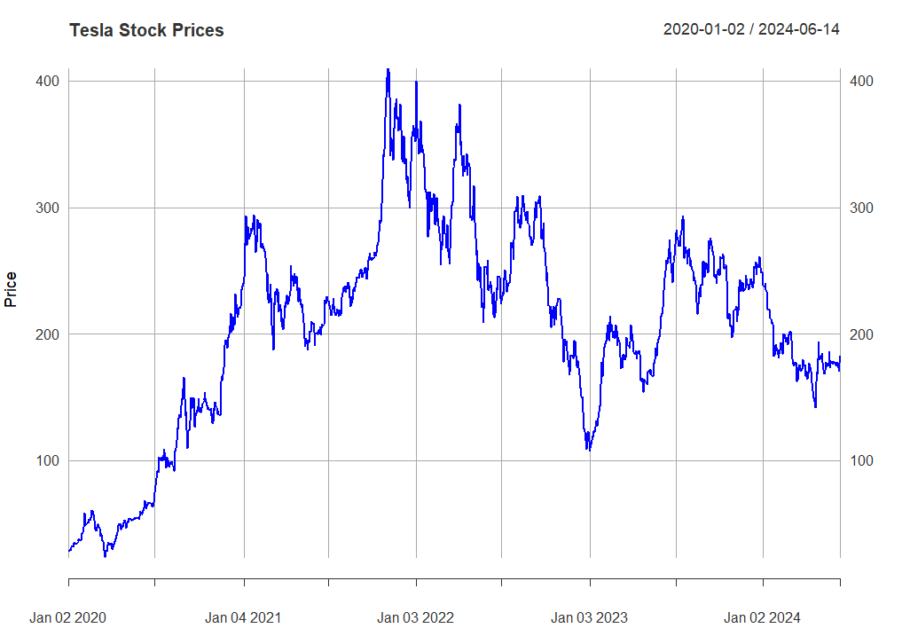
Visualize the Time Series

Slide 7
Visualize the Time Series
Significant growth early in the period, peaking in early 2021.
High volatility with notable peaks and troughs.
Major peak in early 2021 (~$400), significant troughs mid-2022 and late 2023.
Frequent fluctuations indicate market reactions to various events.
Despite volatility, the stock price remained higher than the start.

Slide 8
Stationarize the Series
What is Stationarizing ?
Stationarizing a time series involves transforming it to make its statistical properties (mean, variance, autocorrelation) constant over time.
Why is Stationarizing Important?
Many time series models, including ARIMA, assume the series is stationary for accurate modeling and forecasting.
Stationary series are easier to model and predict because their behavior is consistent over time.

Slide 9
Test for Stationarity
Augmented Dickey-Fuller (ADF) Test : To statistically determine if a time series is stationary.
Null Hypothesis
The series has a unit root (i.e., it is non-stationary).
Alternative Hypothesis
The series does not have a unit root (i.e., it is stationary).
P-value (Threshold) : Typically, a significance level (α) of 0.05 is used.
If p-value > 0.05: Fail to reject the null hypothesis. The series is likely non-stationary.
If p-value ≤ 0.05: Reject the null hypothesis. The series is likely stationary.

Slide 10
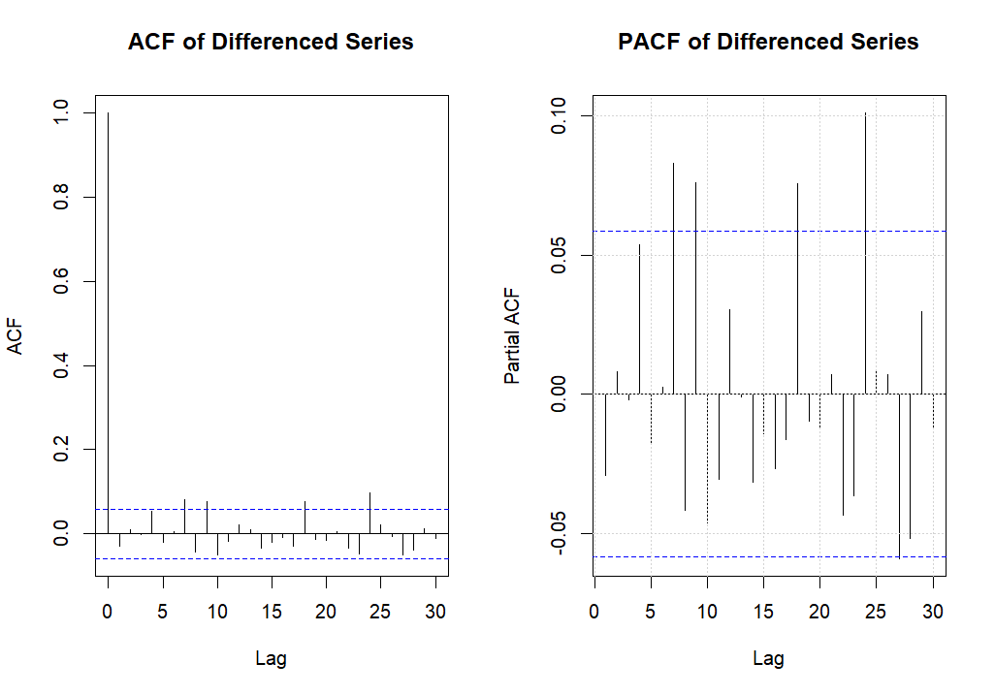
ACF/PACF Charts

Slide 11
ACF Plot
The ACF plot of the differenced series shows no significant spikes beyond lag 0.
This indicates that there is no substantial autocorrelation left in the differenced series.
This suggests that the moving average component (q) is not needed, i.e., q = 0.
PACF Plot
The PACF plot of the differenced series also shows no significant spikes beyond lag 0.
This indicates that there is no substantial partial autocorrelation left in the differenced series.
This suggests that the autoregressive component (p) is not needed, i.e., p = 0.

Slide 12
ARIMA Model Development
Initial
p-Value : 0.475
p-Value > 0.05, we fail to reject the Null Hypothesis.
Use differencing to Stationarize it with d = 1
P-Value after differencing : 0.01
Referred ACF and PACF graphs for p and q values
Selected p and q values using auto.arima()
p = 0 & q = 0
ARIMA(0,1,0)

Slide 13
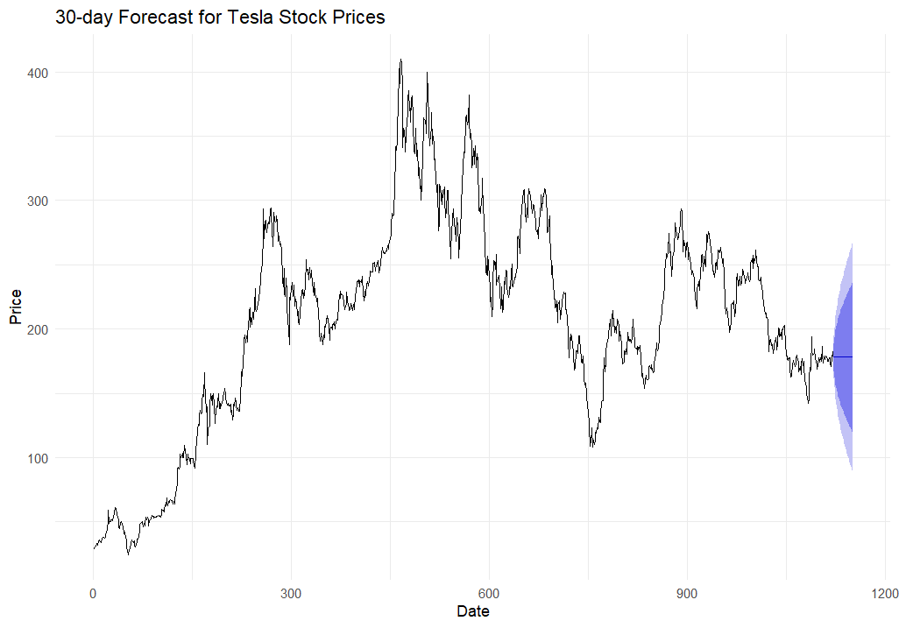
Predictions
Stock Price Prediction for the next 30 days

Slide 14
Predictions
The forecasted prices are represented by a continuation of the line plot extending to the right.
There is a visible blue shaded area around the forecasted prices, which represents the confidence interval of the forecast.
The blue shaded area indicates the range within which the actual stock price is expected to lie with a certain level of confidence (typically 95% in most forecasts).
A wider shaded area suggests greater uncertainty in the forecast, while a narrower area indicates higher confidence in the predicted values.
In this plot, the confidence interval widens over time, indicating increasing uncertainty as the forecast horizon extends.

Slide 15
Evaluation
RMSE | MAE | MAPE
8.325 | 5.798 | 2.998
An RMSE of 8.32 indicates that, on average, the forecasted stock prices deviate from the actual prices by about 8.32 units. For stock prices, this can be considered relatively low if the stock price is in the range of hundreds of dollars, suggesting that the model has a reasonable level of accuracy.
An MAE of 5.79 means that, on average, the forecasted stock prices are off by about 5.79 units.
A MAPE of 2.99% indicates that the forecasted prices deviate from the actual prices by about 2.99% on average. This is a relatively low percentage, suggesting that the model performs well in terms of percentage accuracy.

Slide 16

Dive into the Code

Slide 17
